Slide 1
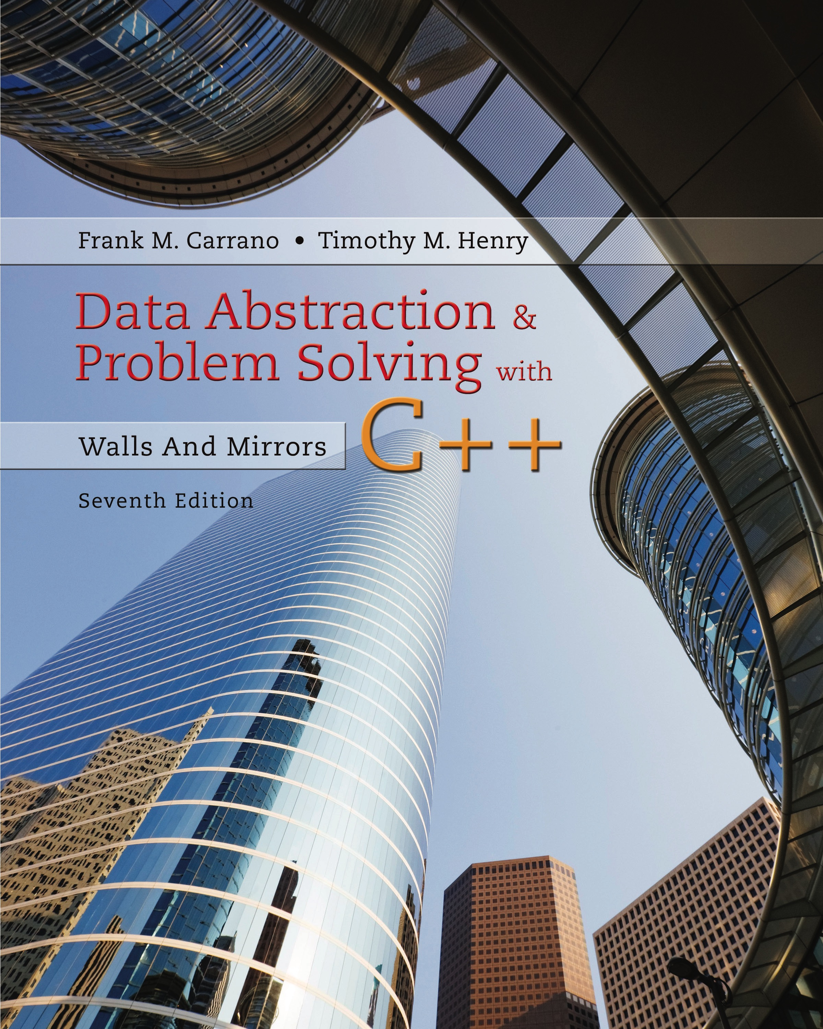
Data Abstraction & Problem Solving with C + +: Walls and Mirrors
Seventh Edition
Chapter 14
Queue and Priority Queue Implementations
Copyright © 2017, 2013, 2007 Pearson Education, Inc. All Rights Reserved
Notes:
If this PowerPoint presentation contains mathematical equations, you may need to check that your computer has the following installed:
1) MathType Plugin
2) Math Player (free versions available)
3) NVDA Reader (free versions available)

Slide 2
Implementations of the A D T Queue
Like stacks, queues can have
Array-based or
Link-based implementation.
Can also use implementation of A D T list
Efficient to implement
Might not be most time efficient as possible

Slide 3
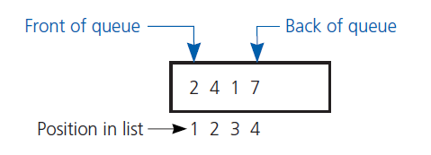
An Implementation That Uses the A D T List (1 of 6)
Figure 14-1 An implementation of the A D T queue that stores its entries in a list

Slide 4
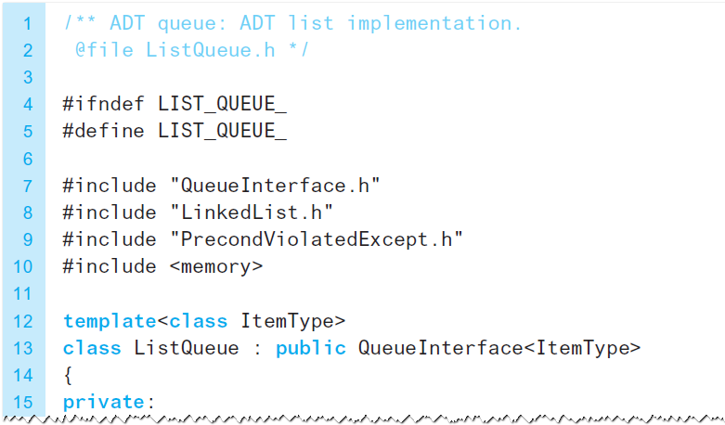
An Implementation That Uses the A D T List (2 of 6)
Listing 14-1 The header file for the class ListQueue

Slide 5
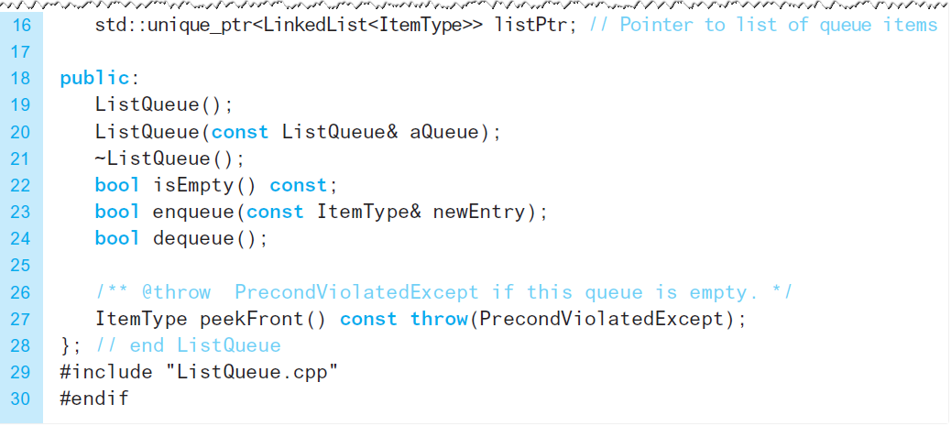
An Implementation That Uses the A D T List (3 of 6)
Listing 14-1 [Continued]

Slide 6
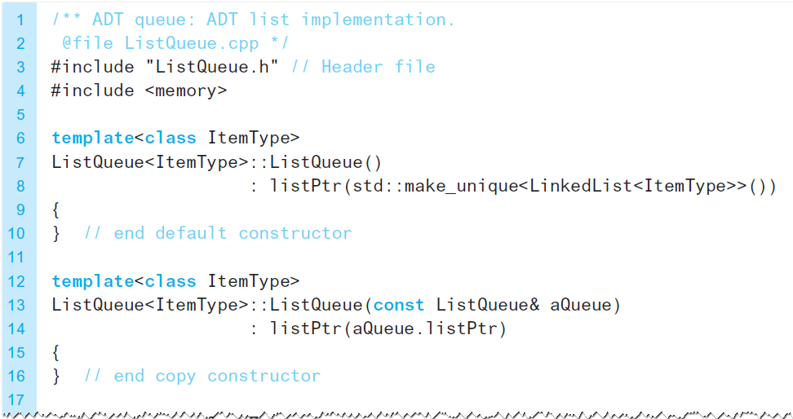
An Implementation That Uses the A D T List (4 of 6)
Listing 14-2 The implementation file for the class ListQueue

Slide 7
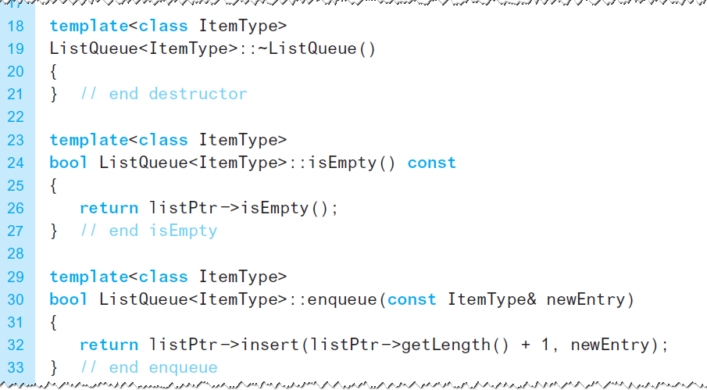
An Implementation That Uses the A D T List (5 of 6)
Listing 14-2 [Continued]

Slide 8
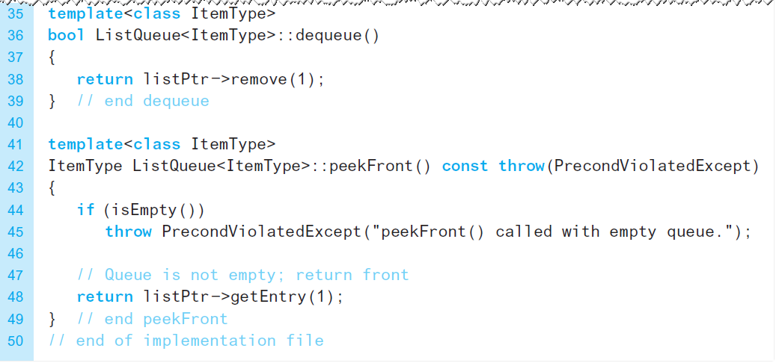
An Implementation That Uses the A D T List (6 of 6)
Listing 14-2 [Continued]

Slide 9
A Link-Based Implementation (1 of 11)
Similar to other link-based implementation
One difference … Must be able to remove entries
From front
From back
Requires a pointer to chain’s last node
Called the “tail pointer”

Slide 10
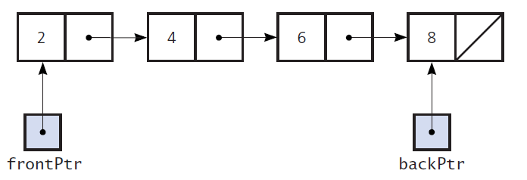
A Link-Based Implementation (2 of 11)
Figure 14-2 A chain of linked nodes with head and tail pointers

Slide 11
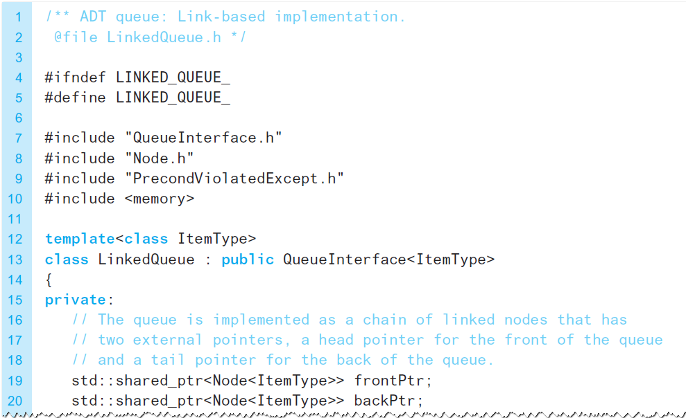
A Link-Based Implementation (3 of 11)
Listing 14-3 The header file for the class LinkedQueue

Slide 12
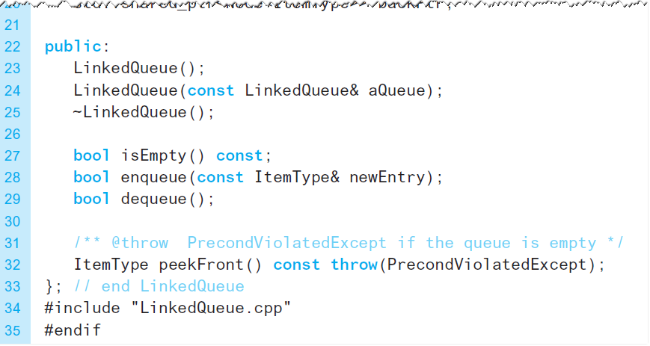
A Link-Based Implementation (4 of 11)
Listing 14-3 [Continued]

Slide 13
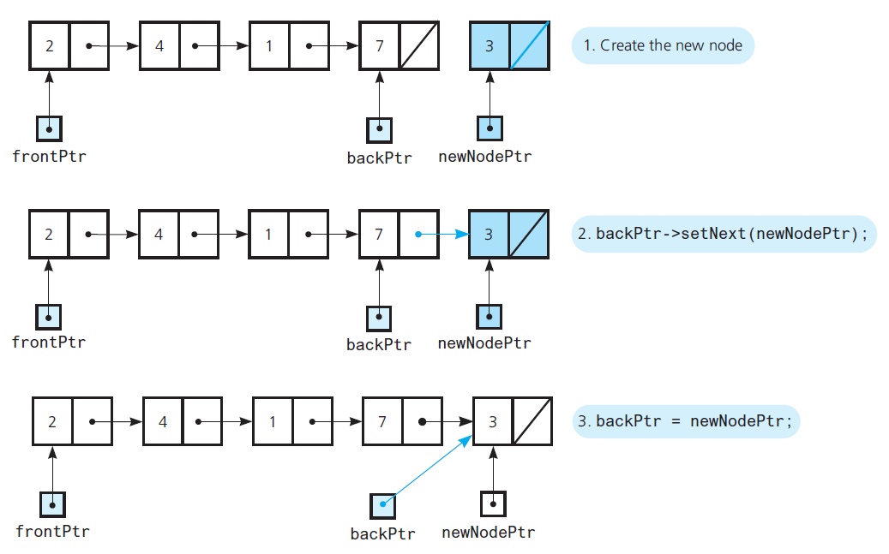
A Link-Based Implementation (5 of 11)
Figure 14-3 Adding an item to a nonempty queue

Slide 14
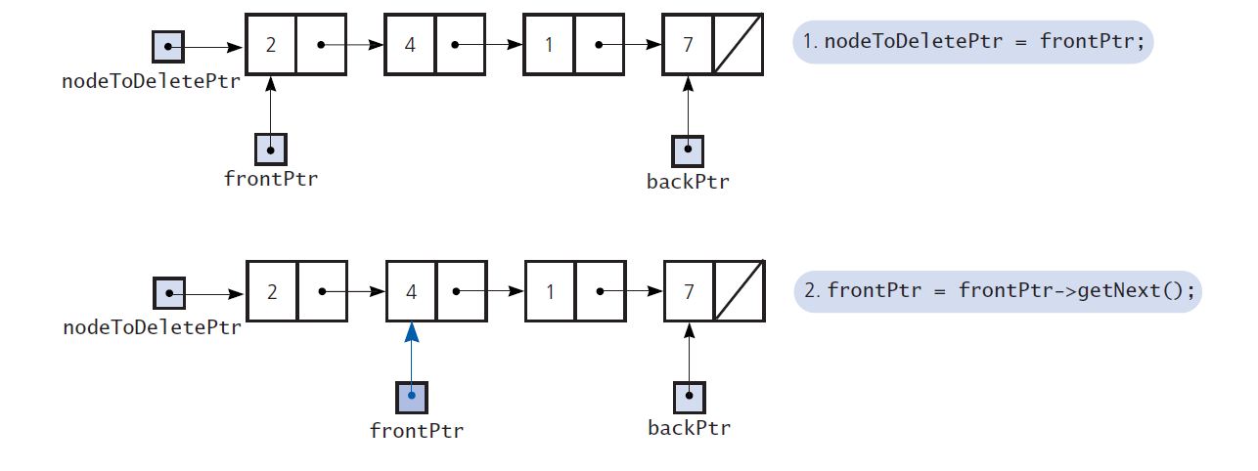
A Link-Based Implementation (6 of 11)
Figure 14-5 Removing an item from a queue of more than one item

Slide 15
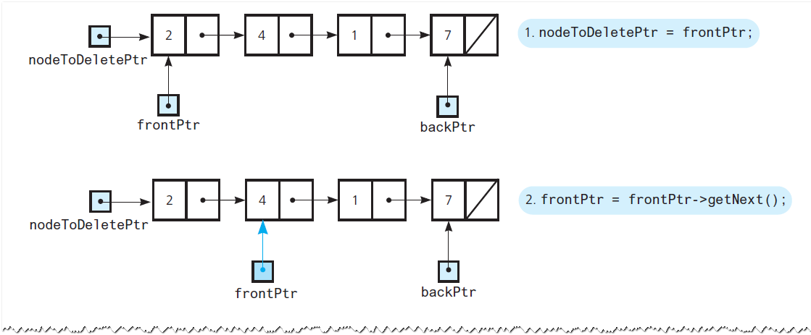
A Link-Based Implementation (7 of 11)
Figure 14-5 [Continued]

Slide 16
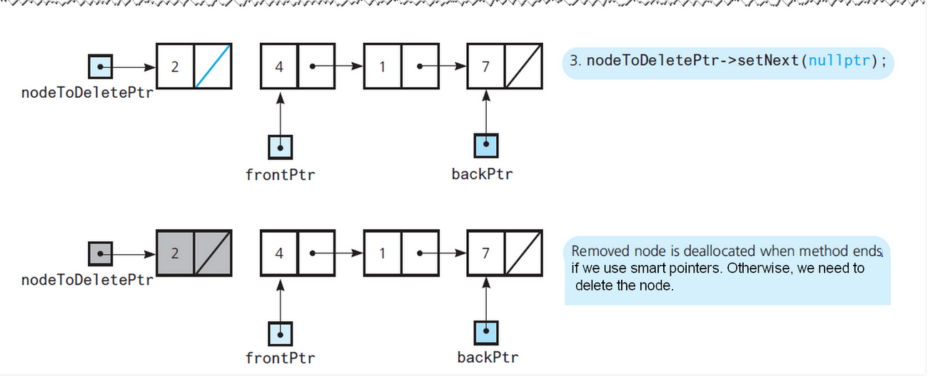
A Link-Based Implementation (8 of 11)
Figure 14-5 [Continued]

Slide 17
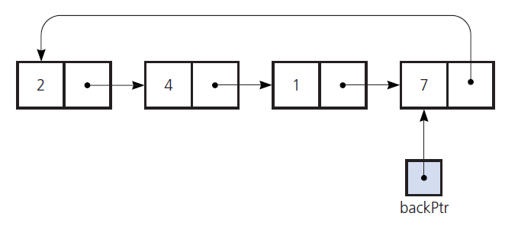
A Link-Based Implementation (9 of 11)
Figure 14-6 A circular chain of linked nodes with one external pointer

Slide 18
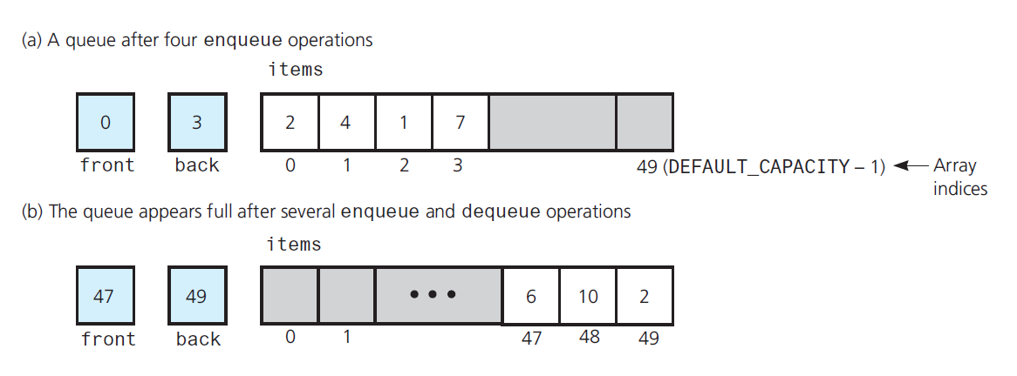
A Link-Based Implementation (10 of 11)
Figure 14-7 A naive array-based implementation of a queue for which rightward drift can cause the queue to appear full

Slide 19
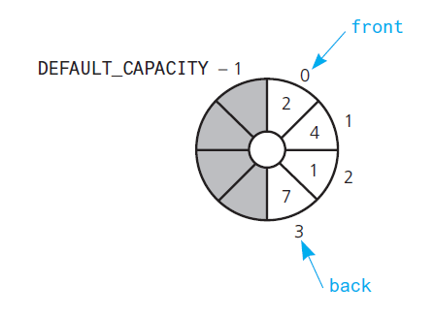
A Link-Based Implementation (11 of 11)
Figure 14-8 A circular array as an implementation of a queue

Slide 20
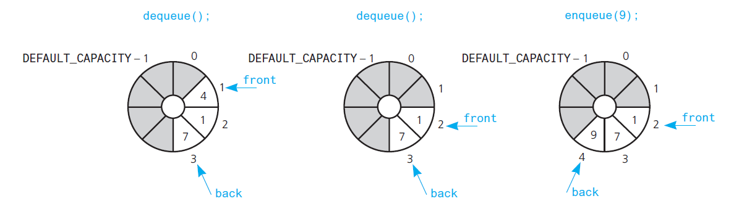
An Array-Based Implementation (1 of 9)
Figure 14-9 The effect of three consecutive operations on the queue in Figure 14-8

Slide 21
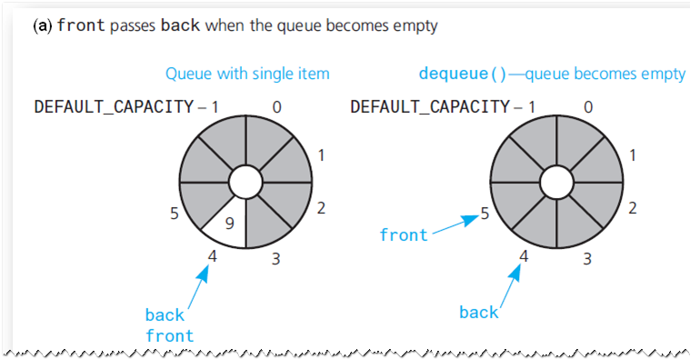
An Array-Based Implementation (2 of 9)
Figure 14-10 front and back as the queue becomes empty and as it becomes full

Slide 22
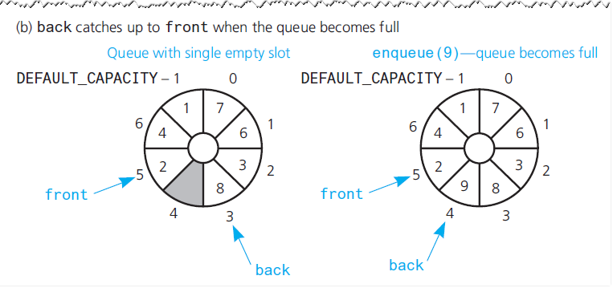
An Array-Based Implementation (3 of 9)
Figure 14-10 [Continued]

Slide 23
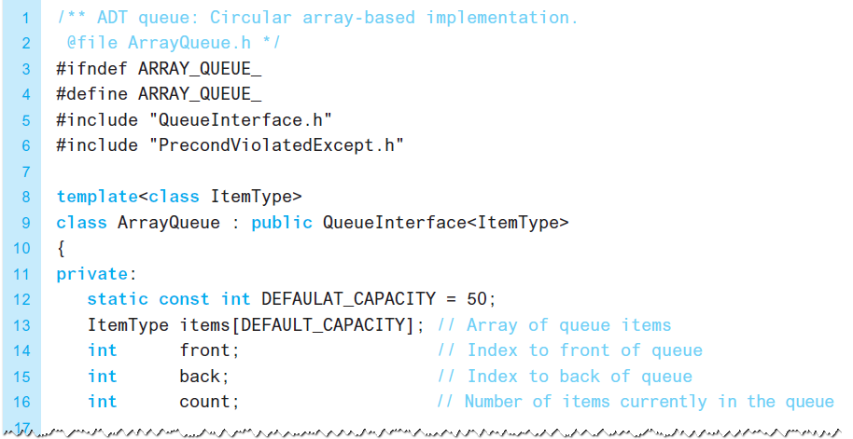
An Array-Based Implementation (4 of 9)
Listing 14-4 The header file for the class ArrayQueue

Slide 24
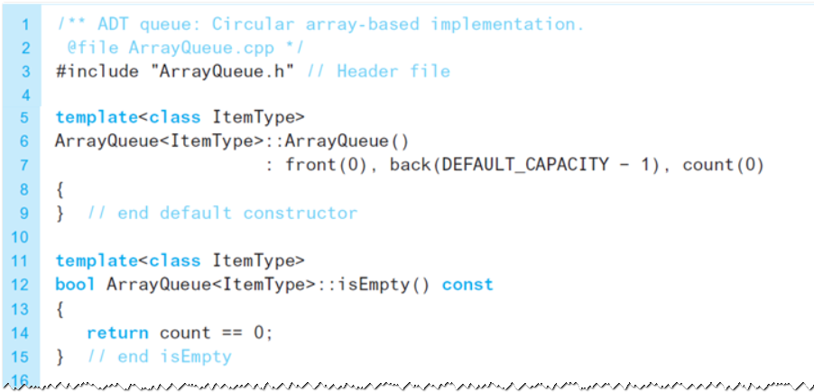
An Array-Based Implementation (5 of 9)
Listing 14-5 The implementation file for the class ArrayQueue

Slide 25
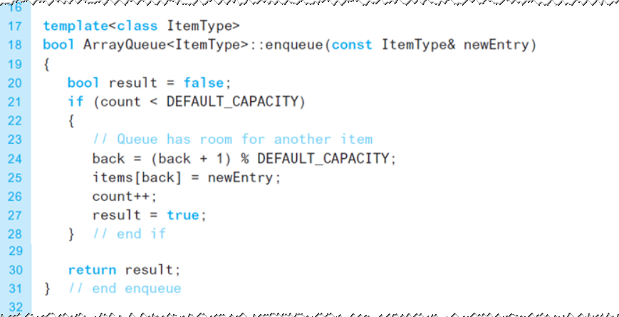
An Array-Based Implementation (6 of 9)
Listing 14-5 [Continued]

Slide 26
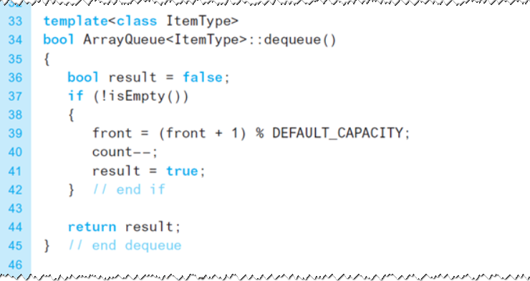
An Array-Based Implementation (7 of 9)
Listing 14-5 [Continued]

Slide 27
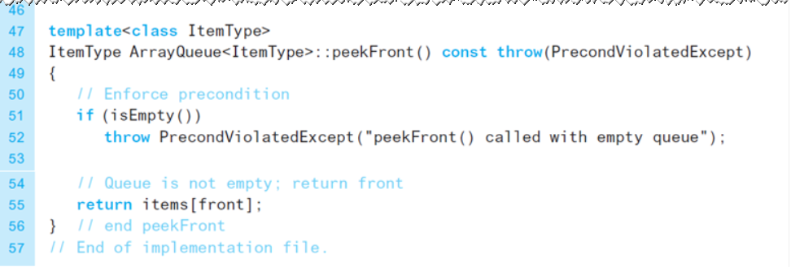
An Array-Based Implementation (8 of 9)
Listing 14-5 [Continued]

Slide 28
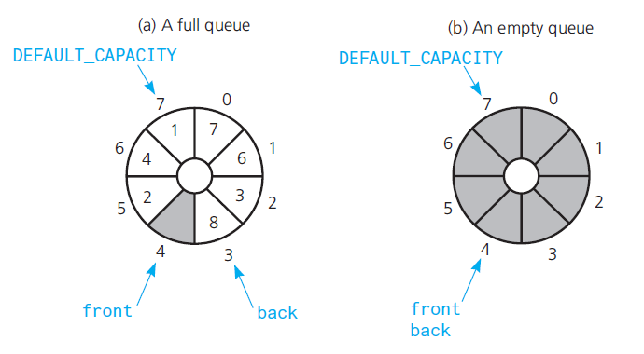
An Array-Based Implementation (9 of 9)
Figure 14-11 A circular array having one unused location as an implementation of a queue

Slide 29
Comparing Implementations
Issues
Fixed size (array-based) versus dynamic size (link-based)
Reuse of already implemented class saves time

Slide 30
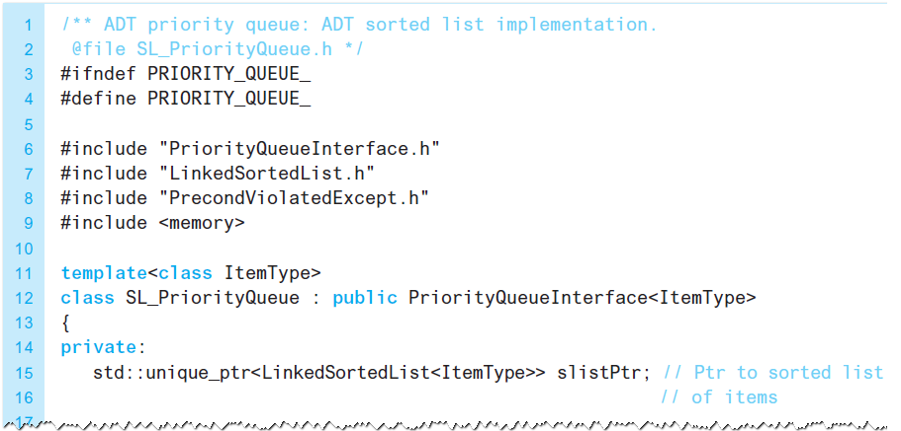
An Implementation of the A D T Priority Queue (1 of 2)
Listing 14-6 A header file for the class S L_PriorityQueue.

Slide 31
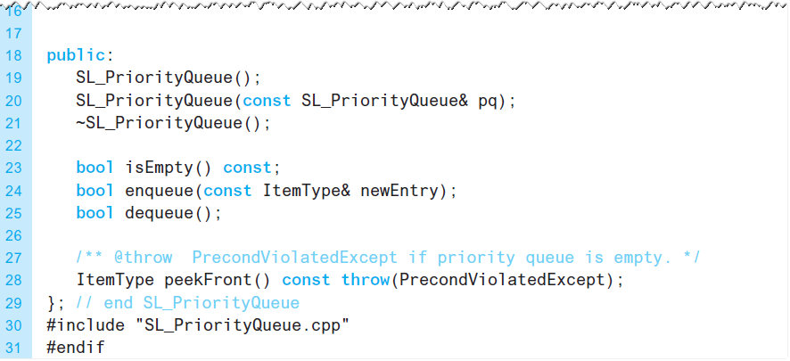
An Implementation of the A D T Priority Queue (2 of 2)
Listing 14-6 [Continued]

Slide 32

Copyright

